Slide 1
Three Body Problem
On finding period in chaos
By Minliang LIN

Slide 2
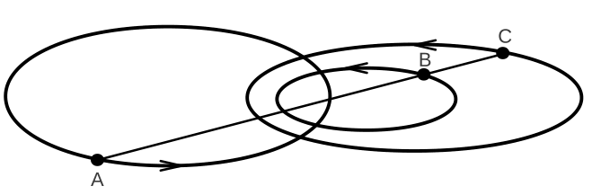
What is 3-body problem?
3 mass points
Initial positions and velocities are known
Mutual gravity only
Subsequent motion?
Credited to Euler
Notes:
Important: Sun, earth and moon
Earth, moon and spacecraft

Slide 3
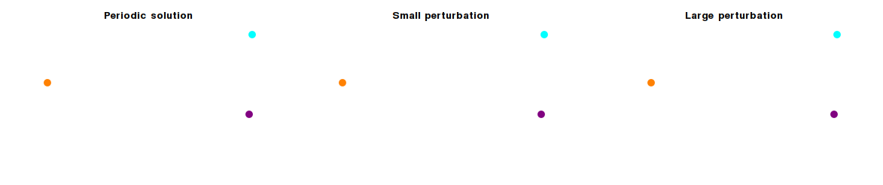
A 300-year hard problem
No simple analytical solution
Unbearably slow series solution
Generally chaotic (no-repeating)

Slide 4
Find period orbits numerically
How to compute?
How to prove existence?
Is it stable?
Notes:
Synergy of analytic and numerical work
Other things to consider:
Collision/singularity
Stable: no definition

Slide 5
How to compute
[2013] Milovan Suvakov and V. Dmitra sinovic
Very special initial condition
Try and refine

Slide 6
Initial condition
Opposite positions
r1 = r2, r3 = 0
Equal-mass
Opposite velocities
v1=v2=-v3/2

Slide 7
Numerical method
Runge-Kutta method
adaptive step Runge-Kutta-Fehlberg method
Handling collision/singularity
Notes:
Adaptively time step

Slide 8
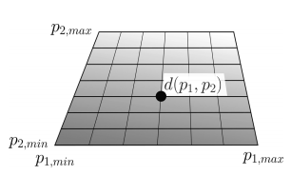
Try and find
Proximity
Difference of velocities and positions, compared with initial condition
OR using Jacobi coordinates to eliminate symmetry
Grid search
Evaluate around the center
Zoom in when the center is minimum

Slide 9
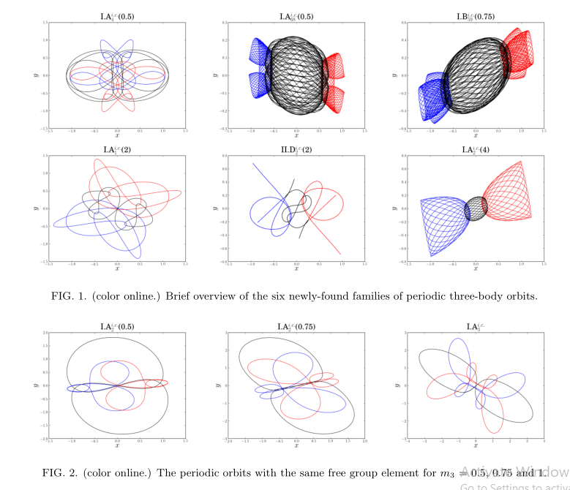
Xiaoming Li et al [2017]
Unequal masses
Longer time period

Slide 10
Reference
Three Classes of Newtonian Three-Body Planar Periodic Orbits https://arxiv.org/abs/1303.0181v1
A guide to hunting periodic three-body orbits http://suki.ipb.ac.rs/AJP_Suvakov_Dmitrasinovic.pdf

